Slide 1

Threat Hunting with Jupyter Notebooks
Presented by: Kai Iyer and Meaghan Neill

Slide 2


Intros – Kai Iyer
Senior Security Engineer, EY Canada
Dev, Blog, Opensource, Privacy
Anime & Manga
find me @kaiiyer

Slide 3

Intro – Meaghan Neill
Threat Hunter and DFIR Analyst, EY Canada
GSEC, GCIH, GCFA
Threat Hunting, DFIR, Adversary Emulation, and Purple Teaming
CTFs, Camping, and Board Games

Slide 4
Basic Definitions
Threat Hunting – Practice of searching for cyber threats that are hiding undetected in a network
MITRE ATT&CK Framework – Knowledge base that tracks threat actor tactics and techniques
Jupyter Notebooks – Web-based interactive computing platform
Sysmon (Sysmon Monitor) – Service and driver that logs system activity to the event log, such as process creations, network connections, and file changes
Windows Event Logs – Record of events related to System, Security, and Applications stored on Windows

Slide 5

SIGMA Rules
Tool used to share detections in a common language
Focused on SIEM (Security and Event Management)
SigmaHQ – Official Sigma Wiki
https://github.com/SigmaHQ/sigma/wiki
Thousands of SIGMA Rules already exist online, as this is an open-source resource meant to be shared and edited by the community

Slide 6
A Few More Definitions
Anomaly Detection – Identification of rare events or observations which are not normal activity for a host or user
Visualizations – Shows anomaly detections in a visual way such as a Blot Graph or Edge List Graph; Can be easier to read and see any outliers
Isolation Forests – Algorithm using binary trees used to detect anomalies, as opposed to just outliers

Slide 7

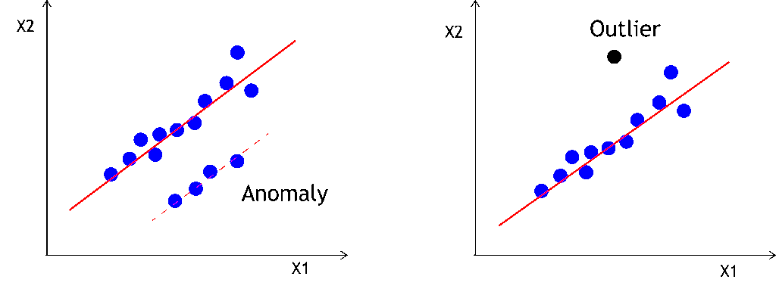
Outlier Vs Anomaly
Anomaly – Data that occurs very rarely in the data set and whose features differ from most of the other data
Outlier – Observation which appears to be inconsistent with the remainder of the set of data; Usually is far away from other data in the visualization

Slide 8
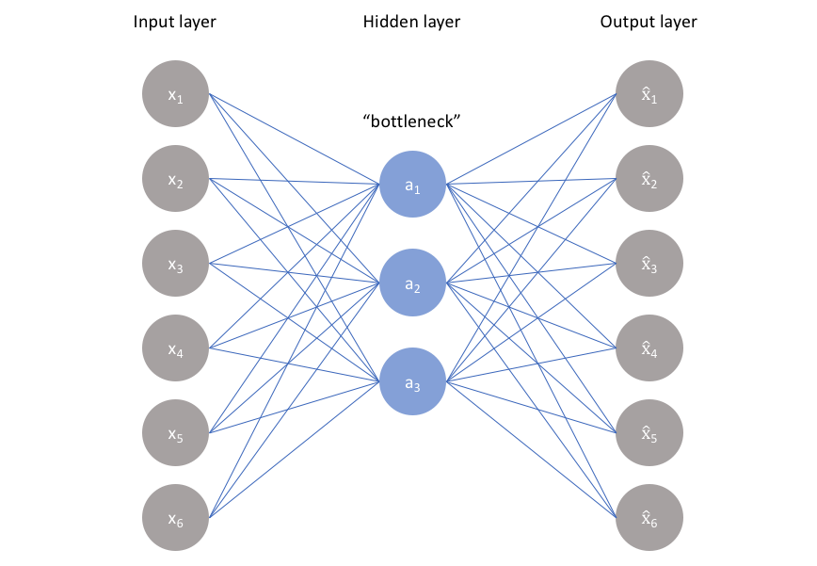
AutoencodeRS
Special type of unsupervised feedforward neural network
Accurately capture the key aspects of the provided data to provide a compressed version of the input data, generate realistic synthetic data, or flag anomalies

Slide 9
Autoencoder Definitions
ReLU – Rectified linear unit activation function; Linear function that will output the input directly if it is positive, otherwise, it will output zero
Sigmoid – Activation function that limits neurons output to (0,1)
Adam – Adaptive Moment Estimation; Optimization algorithm
Mean Squared Error (MSE) – Estimator that measures the average of the squares of the errors

Slide 10
Workshop TIME!
Throughout this workshop, we will cover converting SIGMA Logic detections mapped to the MITRE ATT&CK framework into Python using Jupyter Notebooks.
We will also be showing you how you can use anomaly detection and visualizations within Jupyter to be able to detect anomalies.
Once we cover some of the basics and show you some examples, it will be your turn to create these detections and find anomalies in the datasets we provided.

Slide 11
Download files
Please download the files from the following Github for this Workshop
https://github.com/kaiiyer/bsides-edmonton-workshop
Can also clone the repo from Github using
git clone “https://github.com/kaiiyer/bsides-edmonton-workshop”

